Slide 1
FINAL PROJECT

Slide 2
PRESENTATION ON EXPENSES TRACKER

Slide 3
Introduction:
An Expense Tracker is a software application that enables individuals to record, categorize, and analyze their expenses.
It helps users monitor their spending habits, stay within budget, and make informed financial decisions.
By providing insights into where money is going, an expenses tracker can help users budget more effectively, they also identify areas for cost-cutting, and ultimately achieve better financial expenditures.
It enables users to record their spending, categorize expenses, and analyze spending patterns over time.

Slide 4
Working:
The Expenses Tracker works by allowing users to input their expenses, including date, category, amount, and description.
The application stores this data and provides features to view, edit, and delete expenses.
It also offers reporting and analytics capabilities to help users understand their spending patterns.

Slide 5
Uses:
It is used for Personal finance management .
It is used for Budgeting and expense tracking
It is used for the Financial planning and analysis
It is used for the Identifying areas for cost reduction
It is used for the Tax preparation and expense reporting

Slide 6
Advantages:
Easy expense tracking and management
Improved financial awareness and planning
Enhanced budgeting and cost control
Simplified tax preparation and expense reporting
Increased financial discipline and responsibility

Slide 7
Disadvantages:
Initial setup and data entry required
May require regular updates and maintenance
Limited functionality in basic versions
Potential for errors or inaccuracies
Dependence on technology and data security

Slide 8
Future Scope:
Integration with artificial intelligence and machine learning for predictive analytics.
Enhanced mobile and cloud-based accessibility.
Increased automation and synchronization with bank accounts.
Expanded features for investment tracking and financial planning.
Greater emphasis on data security and user privacy.

Slide 9
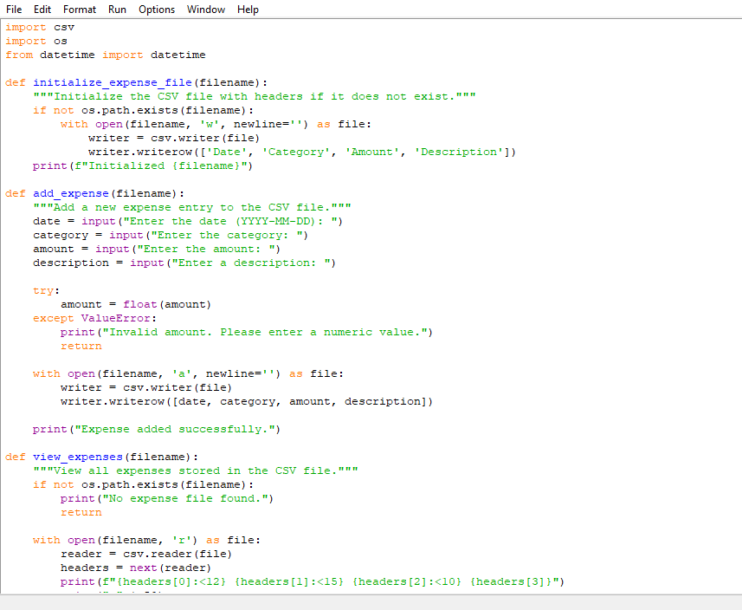
Here is a python code on expenses tracker:-

Slide 10
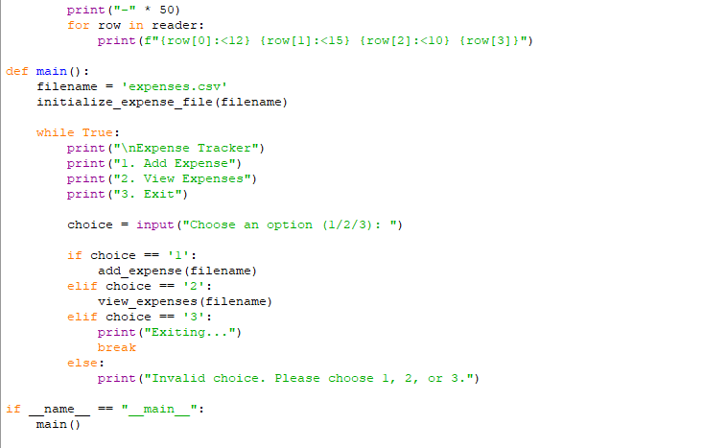

Slide 11
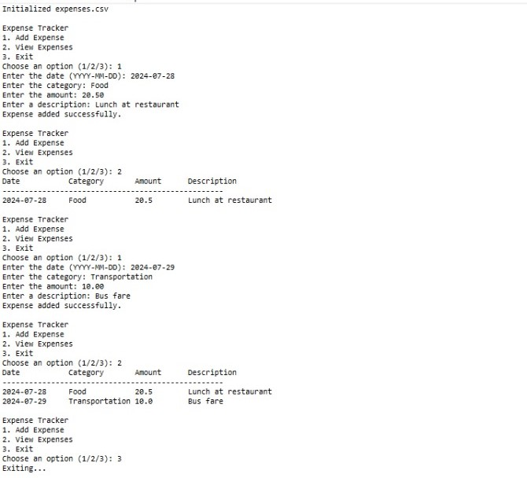
OUTPUT:

Slide 12
THANK YOU

